Slide 1

Week 7
MEETING AFTER the Meeting
&
Follow Up

Slide 2
Meeting after the Meeting
Too much information is disseminate during a meeting, training, seminar etc.
Thus need to breakdown the information and the process is call Meeting after Meeting.

Slide 3
WHEN
Immediately after the main meeting.
Always set a meeting that include a min 30minutes for MAM

Slide 4
Plan Showing: One to One, HBP & UBP
Leverage Senior partner Strength, cross line or the Speaker.
Ask what do you like Best you have seen so far?
Get the Interest gauge from 0-10
UBP: MAM
  Form a Circle with the groups and have a senior to share their experience and the guest to share their experience on One thing they like Best.
  Promote next GMTSS event

Slide 5
Home events
Leverage Senior partner Strength, cross line or the Speaker.
Ask what do you like Best you have seen so far?
MAM: Attend to each guest for any concern or question they may have.

Slide 6
GMTSS:
Local Seminar, Product Symposium, World Conference etc.
MAM during morning queening up, lunch and after the session
Morning: During the queue, great time to share testimonial or success story
MAM Lunch and After the session:
  Form into a small circle.
  Senior partner share about the importance of the meeting and promote the next events.
  Recognize Guests or any pin level jump.
  Have all guest and new UFO to share one thing they learn.
  Best time to gauge Go Now

Slide 7
Failure of MAM
Only One leader share the experience.
Never give new UFO or Guest to share their experience.
Noisy
Several people chatting when main speaker is speaking.

Slide 8
Successful MAM
Understanding of the new UFO or guest on their depht of learning.
Tickets are promoted and sold for the next event.
Home events products are sold
Follow UP appointment are set

Slide 9

Follow Up

Slide 10
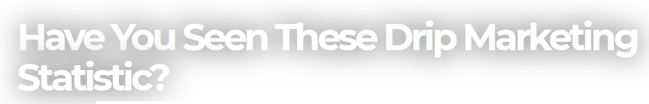
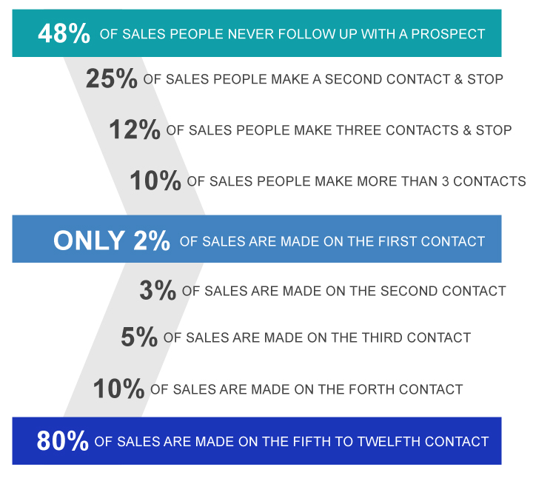
Why Follow Up?

Slide 11
Follow Up Process
Why Follow Up?
  Your success depends on how well you perform the follow up task (80/20 rule)
  Self Follow Up
  Product Follow Up
  Business Follow Up
  Partner Follow Up
The purpose of having an exposure is to have another exposure
We focus on Education and Understanding!

Slide 12
Follow Up (FU) Process
  Self FU ➔ Holding myself accountable to my goal.
    Daily check list with Weekly View
    6x6 momentum check list
    Do something check list
  Product FU ➔ Ensure customer satisfaction, usage compliance and repeat sales
    1-3-5-7-14-21 what is this?
    Add on sales after 1 to 2 repeat sales
  Business FU ➔ What is the next step
    Answer questions and provide more information, must always have the next step until closure is reached
    While the prospect is evaluating the business, we are also evaluating the prospect to make sure it is a good fit
  Partner FU ➔ Ensure duplication and reduce frustration
    Follow the GSG steps and Master UFO program
    Be part of the accountability group. Always follow up on events, activities and assignments
    Keep them inform of events. Love Em, Hug Em and Send Em a Christmas Card

Slide 13
Customer Follow Up
Day 1 : Touch Base / Re-affirmation
Objective
  Thank them for the purchase. Re-affirm them of the decision to start our products
  How is product doing? And any questions?
    If they have not use the product ask if you can call on 3rd Day to check if they have started, if they give you a date they would start then call on that day as Day 3.
Day 3 : Verification
Verify that there are no challenges. This process is most needed for the follow :
  7 days detox – verify they are able to get through withdrawal
  Nutrition Products – make sure body detoxing ok. And work on dosages
  Skincare products – no breakouts
  You may skip this step for home products.

Slide 14
Customer Follow Up
Day 5 : Confirmation
Confirm the products are working well. Share a testimonial and additional usage of how the products can be use or what else the product can help with. Making sure following :
  7 days detox – no more withdrawal
  Nutrition Products – dosage adjusted to the comfort of client
  Skincare products – there are no reaction.
  You may skip this step for home products – if the client is doing ok but can still call to offer other ways of using the product
Day 7 : Follow through & building a relationship:
Call to make sure all is doing well.
Get to know them a little – Use F.O.R.M method to find out their needs.
Answer any open ended questions. And share:
  Webportal
  Testimonials
  Any deals

Slide 15
Customer Follow Up
Day 14 : Just in Case
This process is optional unless there are some challenges you may be facing or the client like you to touch base with them
Remember build a relationship and get to know them and their needs.
Day 21 or Day 35 : Reorder
Very important step!
Check with the clients since they are about to finish the product and if they like to place the order
Example:
  “ This is < your name> . How are you? I am so glad you are doing well with the products. We want you to continue the great experience, and know that you are almost out of the product, would you like us to send you a bottle or drop off a bottle( if you are close by) . Is there any one you like to share your experience with ( Offer referral program if you like)

Slide 16
Business Prospect Follow Up
Meeting after the Meeting (MAM)
  Must have an idea of the prospects’ why
  Have a gauge of their interest (0 to 10)
  Always provide information to review and ask for permission for register for FREE preferred customer account on your shop.com
  Always schedule the next follow up appointment before concluding the current appointment until closure
  Follow appointment within 24hr – 48 hr (highly recommend)

Slide 17
Follow up prospects
It ‘s a long term process, be prepared.
Familiar with GMTSS schedule, leverage the training system.
Have a long list, don’t stick with one person.
Keep it short and sweet.
Always leave something with the prospect.

Slide 18
Follow up ourselves
Set bigger goals. Don’t allow yourself just being an average.
Treat yourself as a true leader by accepting responsibilities.
Read every day
Use MA products every day
Do something for your business every day

Slide 19
Follow up new distributors
Be available
1:1 trainings (Getting Started Guide, NDT, B5 etc)
Introduce them to team events and NMTSS
UFO

Slide 20
Follow up team
Build deep
Enough people make enough people

Slide 21
Some team building strategies
Never give away sponsorship
Never place people on someone’s both sides
Build 2 organizations at a time in depth
Don’t re-entry until you have people making solid income on both sides
Don’t finance any one to start his business
Don’t demand your up lines to place people or BV under you

Slide 22
We must promote:
Team work
  Be grateful with what you have
  Treat each other with respect and dignity
  No gossip
Sacrifice
  Sacrifice short-tem pleasure for long-term happiness
  Sacrifice personally for team
Diligence
  You can be slow, but can’t afford to be lazy

Slide 23
Follow up leaders
Develop and maintain 1:1 relationship with your leaders
Set up higher standards for your leaders.
Without a leader, there will never be a team, regardless how many people on the list.

Slide 24
Remember …….
Follow up and Follow through is the key to your success and reaching your goals!

